Slide 1
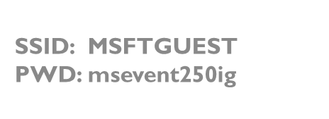
Introduction Reinforcement Learning
Azure Machine Learning Meetup – march 14, 2019

Slide 2
Agenda
Welcome
Definition and examples
A slightly more formal definition
Build a small working sample just using python – no special toolkits
Explore and adjust parameters of the sample to appreciate impact of choices
Wrap up – topic for future session

Slide 3
Why reinforcement learning
Dynamic – feedback loop capable
Does not require extensive pre-training – learn as examples/scenarios are provide and explored
Computationally feasible now due to higher performance hardware and capable frameworks
Does not require extensive labelled data or supervision

Slide 4
More concrete – a RL model consists of
An objective function (i.e. minimize costs and temperature)
A state (current costs, current temperature data)
An algorithm (strategy) that can learn from data to meet the objective function by receiving rewards (feedback)
An ‘agent’ implements actions based on decisions
How is this different from neural nets etc.?
Algorithm needs, or is used, to make decisions and take actions
Algorithm decisions are influenced/improved by prior action/outcome or just the current state
Neural nets often help the learning process

Slide 5
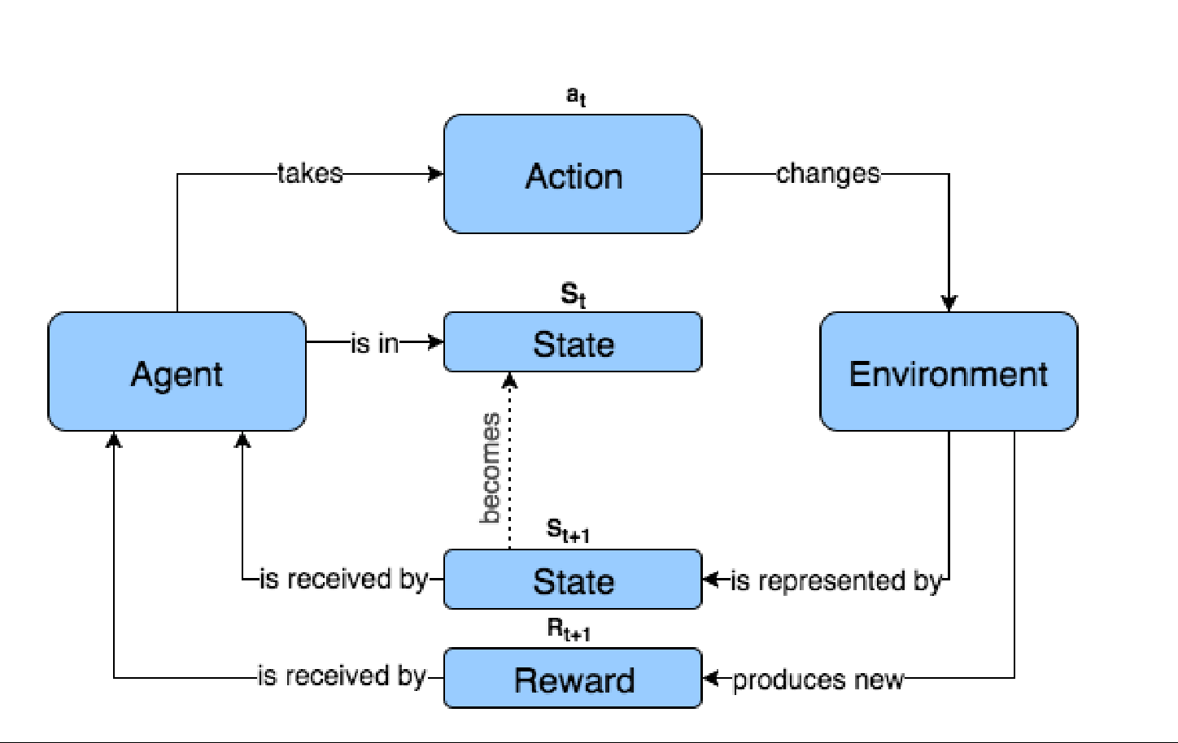
Visual example
Source: Deep Reinforcement Learning In Action V2

Slide 6
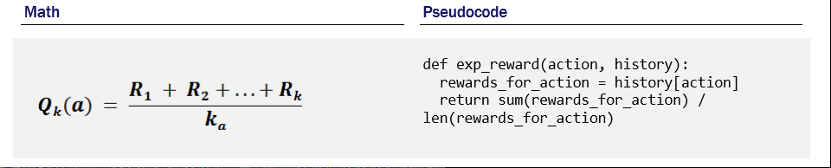
A reward (or Q) function
From: Deep Reinforcement Learning in Action V2

Slide 7
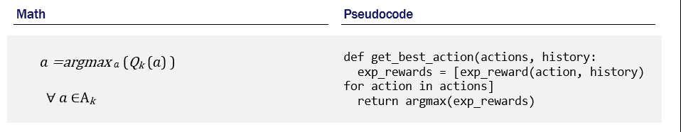
Calculating best reward (payout)

Slide 8
Build a basic reinforcement learning model in python
We’ll create and implement a task using just python code and popular libraries such as scipy , numpy, matplotlib and pandas
This is just to cement some of the terms and ideas
Thanks to Frank La Vigne of Microsoft for the original idea
The problem:
Casino with 10 slot machines (one armed bandits)
Each machine has a different win/loss ratio and payout
Your goal is to find the machine to maximize your winnings
Find the machine with the highest expected value over time
Assume each play is cheap enough that you can be aggressive

Slide 9
High level logic of the sample
Agent
Strategy
Action = Identify Best Slot (highest Expected Value (EV) seen so far)
(stay with best slot EV seen 90% of the time - randomly try other slots 10%)
How?
Value function (expected reward for a slot)
Action (slot to pull)
Reward (-1 if miss, +10 if hit)
Calculating EV (expected value)
Current EV = PriorEV + weightedValue of currentreward
PriorEV = (Sum (priorrewards)) /pullcount+1
currentEV = (currentreward+sum(priorrewards)) / pullcount+1
Ex:
PriorEV = Sum (-1,10,-1,10) / 4 #length of pullcount array is 4
PriorEV = 28/4 = 7
Currentreward=10
CurrentEV = (10+28)/5 (pullcount+1)
CurrentEV = 38/5 = 7.6

Slide 10
Main code snippet
epsvalue = 0.15 #epsilon greedy value (0.1 to 0.2 for most cases)
learnedvalue, reward = multi_armed_bandit(number_of_slot_machines, iterations, epsvalue)
plt.bar(np.arange(len(learnedvalue)),learnedvalue)
plt.show()
print ('learned expected value array ',learnedvalue)
print ("Reward: ", sum(reward))

Slide 11
Core strategy, reward calc etc
#agent+strategy+environment+qfunction all reside here
def multi_armed_bandit(arms, iterations, epsilon):
total_reward, optimal_slot2pull = [], []
expvalue = np.zeros(arms)
playcount = np.zeros(arms)
for i in range(0, iterations):
epsilon_random = np.random.uniform(0, 1)
if epsilon_random > epsilon :
# exploit
slot2pull = np.argmax(expvalue)
else :
# explore
slot2pull = np.random.choice(np.arange(arms))
reward = play_machine(slot2pull)
expvalue[slot2pull] = expvalue[slot2pull] + (1/(playcount[slot2pull]+1)) * (reward - expvalue[slot2pull])
total_reward.append(reward)
optimal_slot2pull.append(slot2pull == np.argmax(expvalue))
playcount[slot2pull] += 1
return(expvalue, total_reward)

Slide 12
Let’s look at sample code
Both will be posted to github.com/jimwill3/
Both samples do the same stuff – one just has a lot of tracing to make the flow and outcomes more visible
You run these anywhere python 3.5 or > is available
I used https://notebooks.azure.com (free Jupyter notebook service) that does not require anything more than a social account (gmail, live.com, etc).
You can use your corporate credentials too (still free) but also then hook into your companies Azure environment (if permitted by your firm - that may not be free!!)

Slide 13
Key (formal) concepts
Agent
Strategy
ValueFunction ( Qfunction)
Environment
State
Reward

Slide 14
Modify the sample
Make the algorithm more ‘greedy’, less greedy.
How would you add a cost per play to the model?
How many iterations are reasonable to feel confident in your results and final ‘best’ slot machine to play decision
What would this problem look like if the slot machine’s payout amounts were random too (i.e. their win rate was the same but the payout amount varied from 1 to 10)
For example – slot 6 has a win rate of 0.3 but payout is uniform random from 1 to 1o dollars

Slide 15
Next time (4 to 5 weeks out)
Our samples were interesting but small – not a large environment, not a lot of states to explore, not a complex reward function
When the state space grows massively, (many choices, many transitions, even rewards that may fall on a scale) Deep Neural Network approaches can help
We’ll start using PyTorch for this so we will have a session on
PyTorch Introduction for Reinforcement Learning
(assumes little prior knowledge of pytorch and we will start with a brief overview of neural nets and deep neaural networks)

Slide 16
appendix
https://github.com/jimwill3/NY-AZML-Meetup
https://msdn.microsoft.com/en-us/magazine/mt830369
Deep Reinforcement Learning in Action Version 2 by Zai and Brown, pub: Manning (there is public github repo for the book)
https://github.com/DeepReinforcementLearning/DeepReinforcementLearningInAction

Slide 17
Agent
Strategy
Identify Best Slot (highest Expected Value (EV) seen so far)
(stay with best slot EV seen 90% of the time - randomly try other slots 10%)
Value function (expected reward for a slot)
Action (slot to pull)
Reward (-1 if miss, +10 if hit)
Calculating EV
Current EV = PriorEV + weightedValue of currentreward
PriorEV = Sum (priorrewards)/pullcount
currentEV = currentreward+(sum(priorrewards) / pullcount+1
Ex:
PriorEV = Sum (-1,10,-1,10,10) / 4
PriorEV = 28/4 = 7
Currentreward=10
CurrentEV = (10+28)/5 (pullcount+1)
CurrentEV = 38/5 = 7.6
Note: EV is not the probability - it is the expected value which (over sufficient iterations) is the mean.
So, if the probability of win is 0.7 and the win =10 ; loss =-1 and you try 100 pulls you may expect:
100* 0.7 = 70 wins and 30 losses
70 wins = 700; 30 losses = -3
total reward = 700 - 30 = 670
your average reward for playing is thus 670/100 = 67

Slide 18
Two ways to calculate running expected value
arr = [1,2,3]
>>> av1 = sum(arr)/len(arr)
>>> av1
2.0
>>> arr.append(4)
>>> av2 = sum(arr)/len(arr)
>>> av2
2.5
av2 = av1 + (1/len(arr))*(4-av1)
>>> av2
2.5

